Slide 1
🛍️ BuyHaven
NAME – SHASHWATH SINGH
SAP ID: 590017043
NAME-HARSH CHAUHAN
SAP ID: 590016645
SUBITED TO : KALLURI SHAREEF BABU
College: UPES, Dehradun
Course: B.Tech CSE, 3rd Semester

Slide 2
Technologies Used
This project is developed using modern web development tools and backend systems. The main technologies used are:
Flask (Python framework) for backend, routing, and server handling
MySQL Database for storing product details, user accounts, and cart information
HTML, CSS, and Jinja Templates for building responsive and dynamic webpages
Bootstrap and Google Fonts for user-friendly UI and modern styling
Session Management in Flask for storing cart items and user authentication
Ngrok to make the local website publicly accessible over the internet
These technologies together enabled a full-stack, functional e-commerce application.

Slide 3
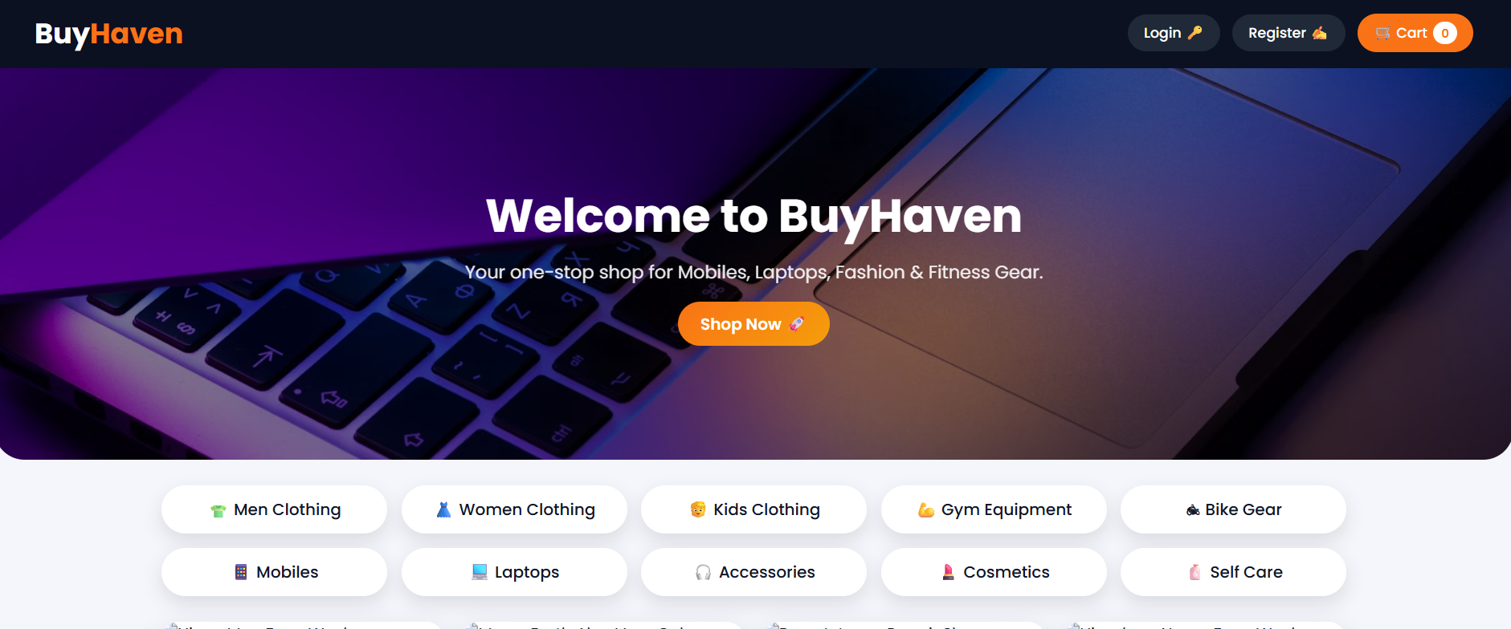
Working of the Project
Homepage & Categories
The website opens with a visually appealing homepage showcasing a hero banner and multiple product categories such as Mobile Phones, Laptops, Gym Equipment, Bike Riding Gear, Self Care, Cosmetics, Men and Women Clothing, and Kids Wear.
Users can click any category to view only the products related to that section.
A search bar is available to quickly find products by name.

Slide 4
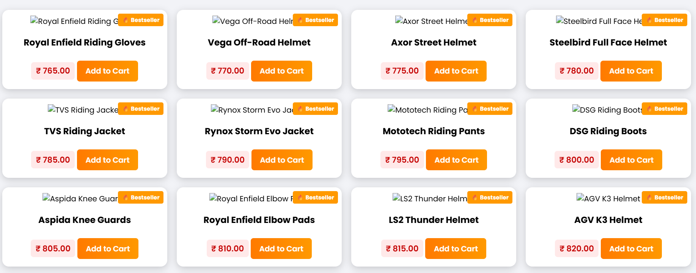
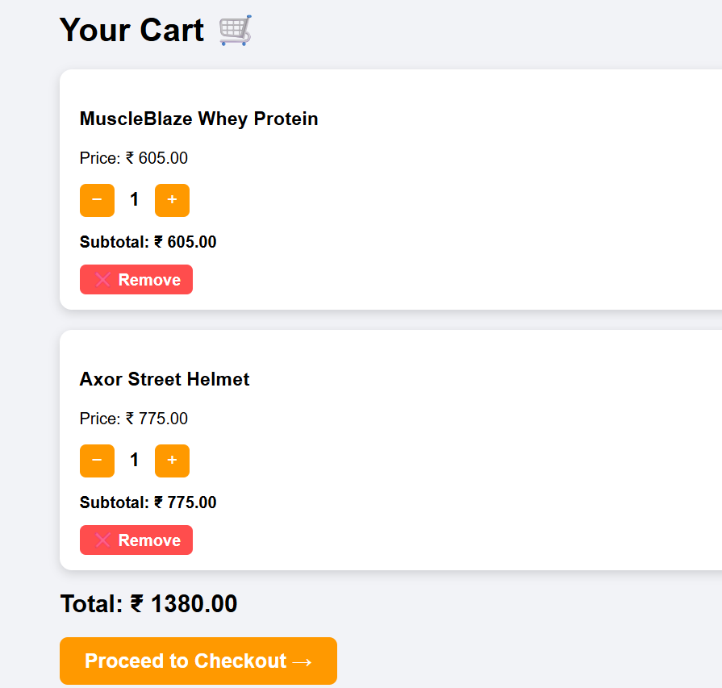
Working of the Project
Product Listing & Cart Functionality
Each product contains price, category, and an add to cart button.
When a user clicks Add to Cart, the item is stored in the session.
The cart page allows users to see selected items, modify the quantity of each product, and remove products if needed.
The cart dynamically calculates the total price based on the selected items.

Slide 5
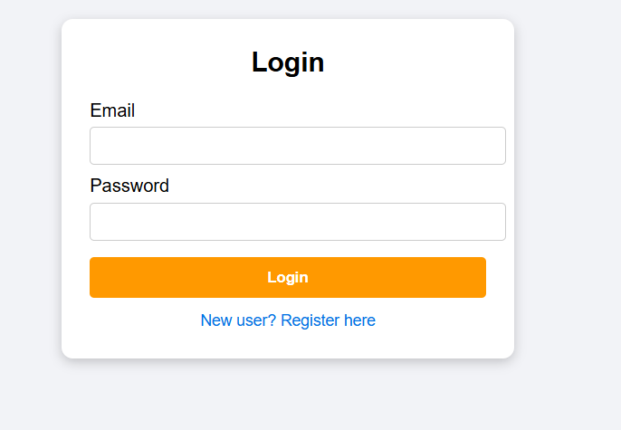
Working of the Project
Database Interaction & User Authentication
The website is connected to a MySQL database.
Product details, price, category, and ID are fetched using SQL queries
Categories are linked to products using foreign keys
Flask handles login and registration using user credentials stored in the database
This makes the system fully dynamic, allowing easy updates and real-time changes.

